Slide 1


HACKNUSA 2026 · HUMAN-CENTRIC SECURITY
Phisang
Reads the peel before you bite.
A Chrome extension, web scanner and API that catches malware and phishing links before the page opens.
Team 23 - Phisang
Notes:
Introduce the team and the one-line idea: Phisang (from 'pisang', banana) checks a link before your browser ever loads it.
1

Slide 2

The padlock no longer means safe
Phishing targets the moment a person clicks, and the old trust signals are easy to fake
59.6%
of phishing sites targeting Indonesia use HTTPS
Core problem
A phishing kit can register a domain, serve a credential form for a few hours, and vanish before any blocklist lists it. Antivirus checks downloads, but a credential form steals what you type. And a feed miss is not proof of safety.
24.4%
of those phishing attacks hit finance, the top sector
Track fit: Human-Centric Security
#2
Indonesia's rank among the most fraud-vulnerable countries
Protection sits at the click itself, needs no security training, and explains its verdict in plain language. The user always keeps the final choice.
Sources: SOCRadar Indonesia Threat Landscape Report 2025; Sumsub Global Fraud Index 2025
Phisang · HackNusa 2026 2
Notes:
Stats: SOCRadar 2025 Indonesia report (HTTPS share of phishing sites; finance as top phishing sector) and Sumsub Global Fraud Index 2025. The human is the target, so the defence belongs at the click.
2

Slide 3



Phisang: one verdict engine, three ways in
Every link gets a classification, a 0–1 risk score and a plain-language risk level
Chrome extension
Web scanner
REST API
Holds the tab on a "checking" page, then blocks or opens it. Go back or Continue anyway.
Paste any suspicious link from WhatsApp, SMS or email and see the verdict and its evidence.
POST /api/v1/analyze lets other apps, bots or mail filters use the same engine.
Risk levels:
SAFE
POTENTIALLY UNSAFE
High Risk
0 – 0.4
0.4 – 0.6
0.6– 1.0
Phisang · HackNusa 2026 3
Notes:
Three surfaces, one backend. The risk bands are the same everywhere so users learn one vocabulary.
3

Slide 4




What makes Phisang different
Not a better blocklist: a verdict for an address nobody has reported yet
Capability | Browser safe-browsing | Antivirus / threat feed | Phisang
Blocks a newly registered domain | No, not yet listed | No | Yes, via page content
Reads the destination page | No | No | Yes, server-side
Tells "unknown" apart from "safe" | Partly | No | Yes, explicitly
Explains its verdict, lets users dispute it | No | No | Yes
Model can't block alone
Typosquat shape wins
Failed ≠ clean
Repeats cost nothing
Needs a doubtful URL or a password field
Brand-agnostic -com / -net rule beats a clean page
Unavailable is logged, never reused
Three cache tiers; cached threats still block
Phisang · HackNusa 2026 4
Notes:
Table: the capability gap. Cards: the four design decisions that are the real USP, as in Chapter 2 of the report.
4

Slide 5
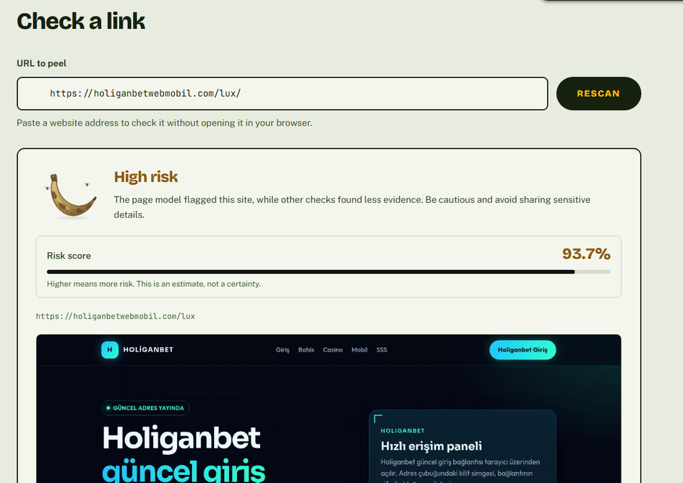
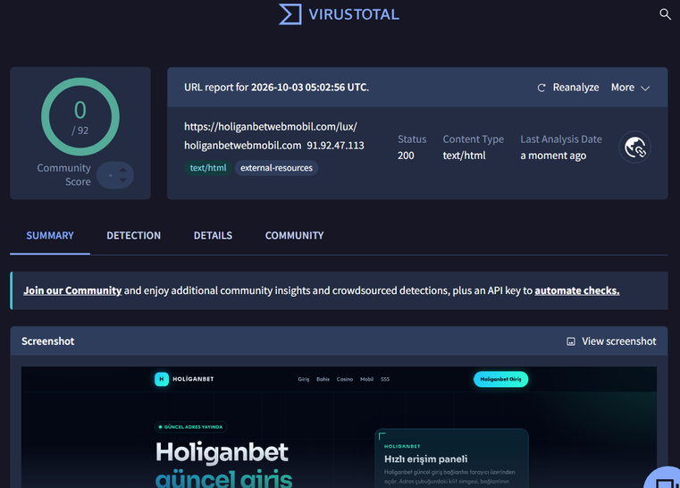
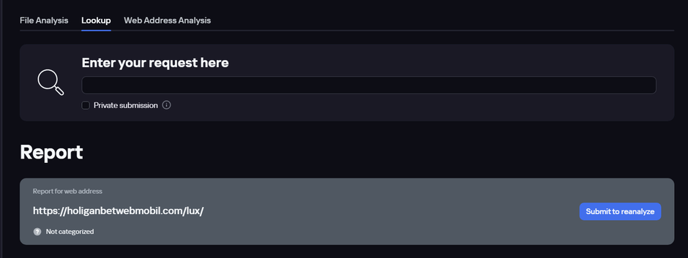

https://phisang.kennethsunjaya.com/
https://www.virustotal.com
https://opentip.kaspersky.com/
Phishtank Record

Slide 6
Proof of concept: running, not described
A public API serving a live SQL Server archive; the extension runs unpacked against it
343
205
227
0.44 s
scans in the live archive
distinct addresses checked
automated tests (193 backend, 32 worker, 2 browser)
model inference per page, CPU only
Live demo links
Test link | Decided at | Result
https://www.google.com/search?q=youtube | Lexical rules, never fetched | benign · SAFE
http://77.73.133.113/lego/mine.exe | Content guard: a file, not a webpage | refused · tab paused
https://holiganbetwebmobil.com/lux/ | Typosquat shape, page fetched | malicious if score ≥ 0.6
https://secure-login-paypal-verify.account-update.xyz/signin | Fetch fails | unavailable, never benign
Phisang · HackNusa 2026 5
Notes:
Lead with the numbers: this is deployed. Also: 2 false-positive reports already filed through the UI; ~3,400 lines Python, 970 extension JS, 1,100 React. Model evaluated on 300 unseen pages plus 33 hand-labelled files. Then demo the four links.
5

Slide 7
Phisang · HackNusa 2026
Notes:
Lead with the numbers: this is deployed. Also: 2 false-positive reports already filed through the UI; ~3,400 lines Python, 970 extension JS, 1,100 React. Model evaluated on 300 unseen pages plus 33 hand-labelled files. Then demo the four links.
5

Slide 8
Notes:
Lead with the numbers: this is deployed. Also: 2 false-positive reports already filed through the UI; ~3,400 lines Python, 970 extension JS, 1,100 React. Model evaluated on 300 unseen pages plus 33 hand-labelled files. Then demo the four links.
5

Slide 9
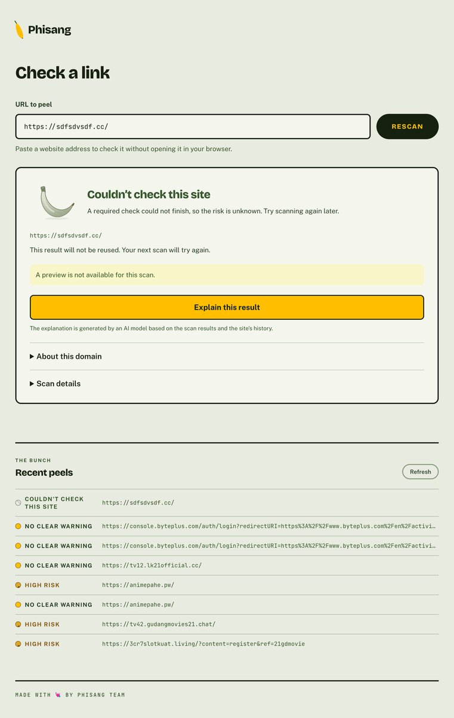
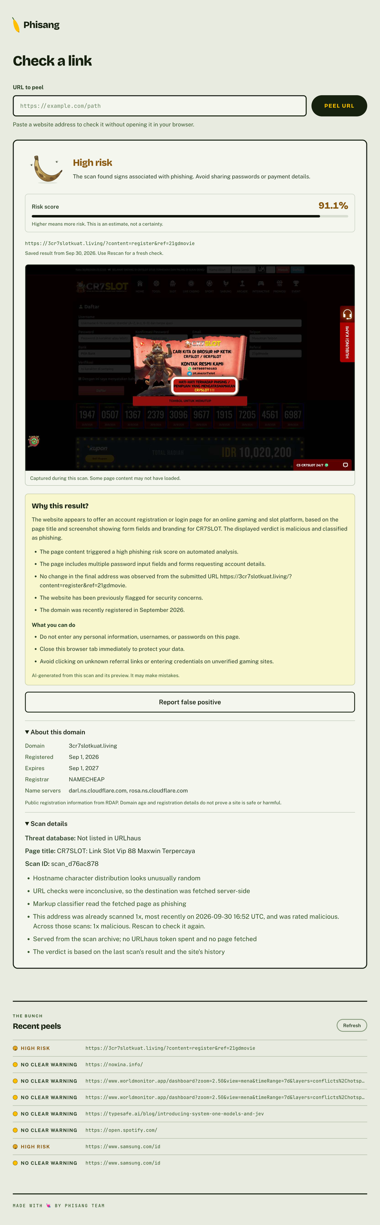
Core features in action
The tab is held before the site is contacted, not after
1
You click a link
Any http(s) navigation
2
Tab is held
Before the site is contacted
3
Phisang checks
Local cache, then API with live progress
4
Warn or release
Go back, or Continue anyway once
Warning page
Completed web scan
More screens and a recording: tinyurl.com/phisang-hacknusa
Phisang · HackNusa 2026 6
Notes:
Use screenshots from the Drive folder. Mention: a cache hit releases the tab with no request; a check that could not finish still opens the page with a banner; reports are review-only.
6

Slide 10
Technical architecture & tech stack
Only the fourth gate opens the page, and a file link never reaches it
FASTAPI BACKEND · STAGES
OUTCOME
Chrome extension
MV3, plain JavaScript
0 · Content guard
file links refused
not a webpage
Local cache
per hostname, 6 hours
1 · Scan archive
SQL Server, shared
saved verdict
cache hit: released, no request
2 · Threat feed
URLhaus: URL, path, IP
malware · High Risk
Web scanner
React 19 + Vite
3 · Lexical rules
clears Tranco / known hosts
benign, never fetched
4 · Page analysis
Chromium, then Laya
verdict, corroborated
Python + FastAPI
Playwright
ModernBERT-large
SQL Server
Chrome MV3
React 19
Phisang · HackNusa 2026 7
Notes:
Design rule: page fetch costs orders of magnitude more than every other check, so answer as much as possible before it. Only the URL leaves the browser; fetched HTML is scored in process and discarded. Inference reads cleaning rules from the model's metadata.json, so it cannot drift from training.
7

Slide 11





Security framework
The service fetches what strangers submit, so it treats its own fetcher as hostile
SSRF: two layers
Hardened host
Files never fetched
Phisang checks before and after DNS, incl. obfuscated IPs; systemd IPAddressDeny blocks the same ranges in the kernel.
Non-login user, ProtectSystem=strict, syscall filter, 3 GB and 45 s ceilings, Unix socket, Chromium sandbox kept.
Content guard at five points: client, API entry, each redirect hop, each navigation, final response.
XSS-safe rendering
Reports can't flip verdicts
Only the URL leaves
Attacker-written page titles and URLs render as text; a smoke test asserts it.
False-positive reports are review-only, so a site owner can't talk a flag down.
Fetched HTML stays on the server and never goes to the AI provider; query strings stripped from logs.
Stated residual risks: no authentication or rate limiting yet; the shared archive makes scanned URLs visible to the operator.
Phisang · HackNusa 2026 8
Notes:
Example attack: submit http://169.254.169.254/latest/meta-data/. Both layers reject it. Ports limited to 80, 443, 8080, 8443. Hardening that would force Chromium into --no-sandbox was rejected on purpose.
8

Slide 12
Scalability & deployment readiness
Load grows with distinct addresses, not with visits
Browser cache
Repeat visits to a host: zero requests
0.44 s
1.6 s
45 s
inference / page
model load, once
fetch budget
Shared SQL archive
Later users reuse the first user's scan
Live today: HTTPS reverse proxy, hardened systemd unit, SQL Server persistence. The binding constraint is the Chromium fetch, not the model.
Threat-feed cache
URLhaus answers cached in SQL
Scaling path
1
Add API replicas, raise fetch concurrency
Page fetch + model
Only the first visit to a new address
2
Move the model into its own service, GPU-ready
3
Read replica + signed clean-list at the edge
Phisang · HackNusa 2026 9
Notes:
No per-request state outside SQL Server, so replicas need no coordination. Each new subdomain still earns its own check.
9

Slide 13



Impact
Who is protected, and how it reaches them
E-wallet & bank users
Fake login pages are stopped before a PIN or password is typed, even on a domain registered today.
Every blocked click
= one credential not stolen
Less tech-savvy family
No need to spot a fake domain: a warning page in plain language does the judging, and explains why.
Phisang shifts the defence from "train every user to spot fakes" to "check the link for them, then explain why".
Schools, campuses, small businesses
Managed browsers install the extension by policy, and the shared archive makes each extra seat cheaper.
Phisang · HackNusa 2026 10
Notes:
The managed-browser channel is the go-to-market in the report's commercial release plan.
10

Slide 14
Conclusion
What we built
  A deployed five-stage engine that reads the page, not just its reputation
  Two-layer SSRF defence and a content guard at five points
  A formal "unavailable" state: a failed check is never a clean one
  227 automated tests that encode every decision rule
Honest limits
0.798
AUC on 300 unseen pages
Model quality is the blocker, which is why the model can't block alone. Finishing training and calibrating it comes first.
Our Next Plan: set a proper model threshold → API rate limits & auth → replicas → Chrome Web Store
Phisang · HackNusa 2026 11
Notes:
Also not ready: single API process, unpacked extension, no formal privacy notice. None are architectural dead ends.
11

Slide 15
Thank you. Questions?
Phisang · Reads the peel before you bite.
Team 23 - Phisang · phisang.kennethsunjaya.com · https://github.com/juanariviano/Phisang
Notes:
See Q&A prep in the pitch script.
12

